Slide 1
ECE 231 Final Project
Sebastian Abeyta, Ryan Gonzalez, Carlos Barreto

Slide 2

Project idea: Virtual Library
Our goal was to create a virtual library that could keep track of its own collection of books as well as keep track of what is available and what is checked out.

Slide 3
Objectives:
Store information about each book title, author, ISBN, and genre.
Update when books are checked out or returned.
Implement a search function to locate books based on user criteria.
Have a user-friendly interface

Slide 4
The Structure
Data Structure
This stores the data of the stored books in and out of the library
LibraryManager Class
The LibraryManager is the skeleton that holds the code in place
Functions
These functions different things with book info such as add the book info, search for a book, check a book in or out, etc.
Main Function
Provides the user with the interface that allows them to even use the library in the first place

Slide 5
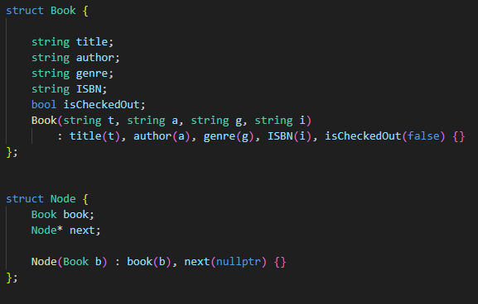
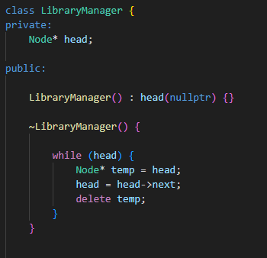
Class and Struct
The Book struct is able to store a books details, and the constructor initializes the books details and sets the checked-out status to false by default
The Node struct represents a node on the linked list. Each node has a book and a pointer to the next node in the list. The constructor for this struct initializes the node with a book and sets next to nullptr
The LibraryManager class manages the library using nodes in a linked list. The constructor initializes head to nullptr and the destructor ensures all nodes are deleted when the LibraryManager object is destroyed to avoid memory leaks. The LibraryManager class also holds all of the functions related to the library

Slide 6
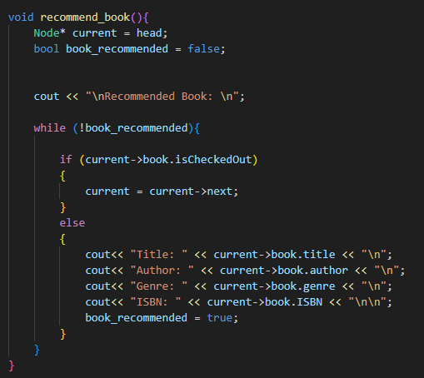
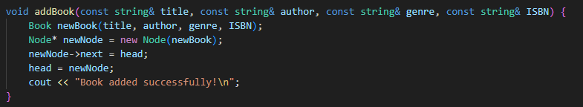
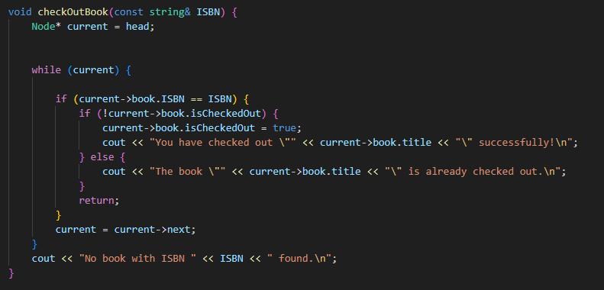
Functions

Slide 7
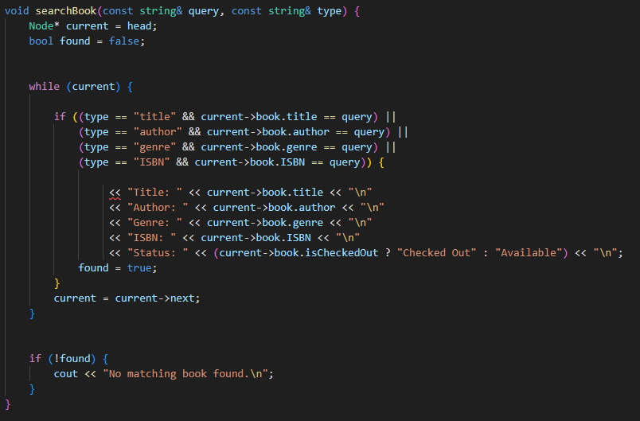
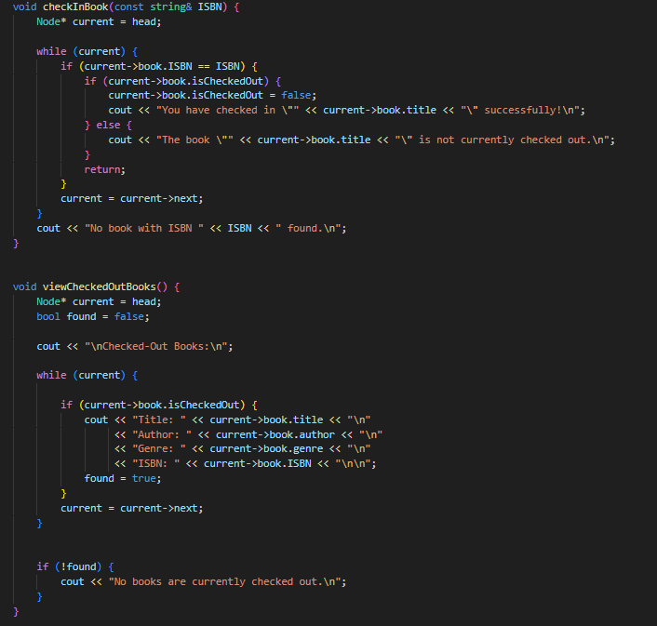
Functions

Slide 8
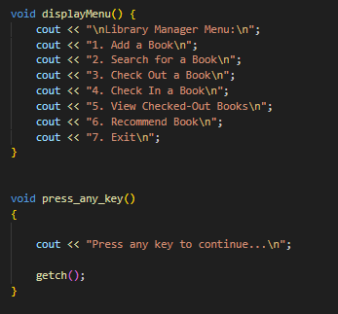
Display menu

Slide 9
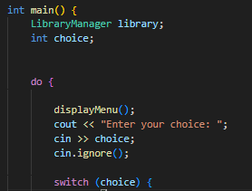
Main Function

Slide 10
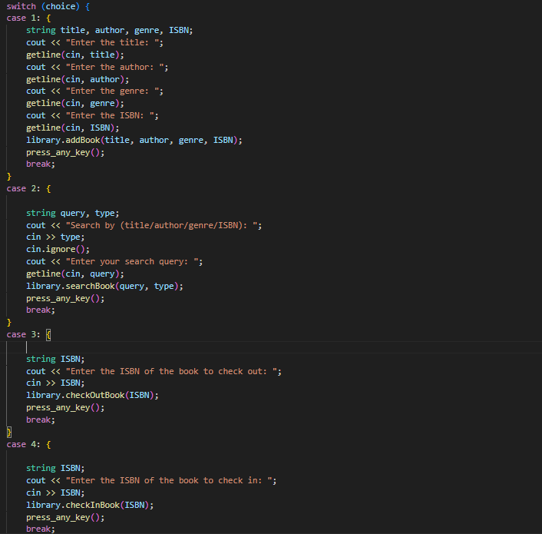
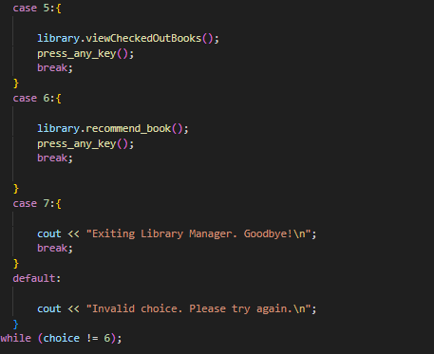
Switch Case

